Slide 1
An R package for the implementation of Efficiency Analysis Trees and the estimation of technical efficiency
Miriam Esteve, Víctor J. España, Juan Aparicio and Xavier Barber
useR 2021
Notes:
Good morning. I am Miriam Esteve and together with my colleagues, Victor España, Juan Aparicio and Xavier Barber, we have worked on the development of a new package in R, recently published in CRAN, on the technical estimation of efficiency.

Slide 2
INDEX
Introduction
Free Disposal Hull (FDH) and Data Envelopment Analysis (DEA)
Classification and Regression Trees (CART) and Efficiency Analysis Trees (EAT)
Random Forest for Efficiency Analysis Trees
eat package
Main functions
Empirical case
Conclusions
Notes:
The presentation is structured with a short introduction on the most used techniques in the analysis of efficiency (FDH and DEA) and the Machine Learning technique (CART) in which we have been inspired for the development of the new techniques (EAT and RF+EAT).
Then, we present the package we have named "eat", its main functions and a small empirical case to show how it works.
Finally, we show the conclusions of our work.

Slide 3
Introduction
FDH, DEA, CART and EAT

Slide 4
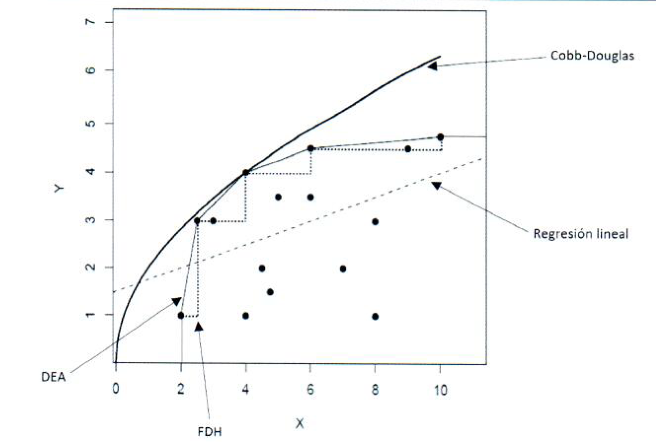
Introduction
A large amount of literature has been developed on:
How to estimate production frontiers
How to measure technical efficiency of production units
What is the purpose of Efficiency Analysis?
Estimating extreme behaviour from above
There are:
Non-parametric techniques
Parametric techniques
DEA has over 100.000 contributions on Google Scholar
Notes:
There is a lot of literature about:
- How to estimate production frontiers
- How to measure the technical efficiency of production units.
Efficiency Analysis does not consist of doing a regression to the mean in which given a cloud of points where there are inputs and outputs you calculate their average. Rather, the aim is to estimate production functions by estimating the extreme behaviour at the top in order to know how the data behaves in this X and Y relationship at the extreme level.
º
There are several techniques for this:
- Non-parametric: DEA and FDH.
- Parametric: Estimating Cobb-Douglas functions.
Moreover, there is a real interest in Efficiency Analysis because, for example, in Google Scholar there are more than one hundreds thousand contributions on DEA.
For this reason, we are going to focus on Non-Parametric Techniques, where DEA and FDH are the most important techniques.

Slide 5
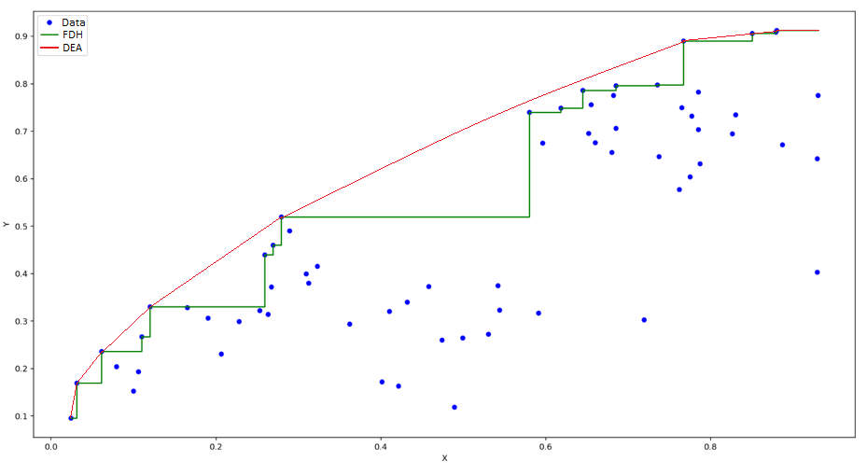
Introduction
Main objective:
n Decision Making Unit (DMUs) to be evaluated.
DMU_{j} consume amount of inputs for the production of amounts of outputs.
The relative efficiency of each DMU is associated with technology:
DEA
Notes:
Its main objective is to analyse the efficiency of a set of observations, which are DMUs (Decision Making Units) that use several inputs to produce several outputs.
For example, companies that use capital and labour to produce shoes.
The relative efficiency of these DMUs is calculated as the distance from each of them to the production frontier. In the case of applying DEA, it would be up to the red line and, in the case of FDH, it would be up to the green line.

Slide 6
Introduction. FDH and DEA
Properties:
Free disposability (or monotonicity) of inputs and outputs are done in this technology.
If , then , as son as
and
Convexity (DEA)
Weaknesses:
DEA and FDH are overfitting in predictive context.
DEA
Notes:
Both techniques comply with the property of free disposability or monoticity, i.e. the production function does not decrease. However, only the DEA also complies with the convexity property. Therefore, we could see in this graph that the FDH could be the skeleton of the DEA.
These techniques, in a predictive context, have the problem of overfitting because they fit so closely to the observed data that they do not allow us to infer beyond the sample.
Therefore, last year, we proposed a new methodology that adapts these techniques to a Machine Learning technique that is able to solve the problem of overfitting because it uses a cross validation process.

Slide 7
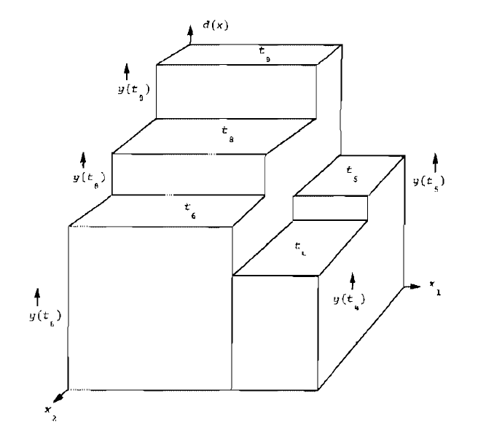
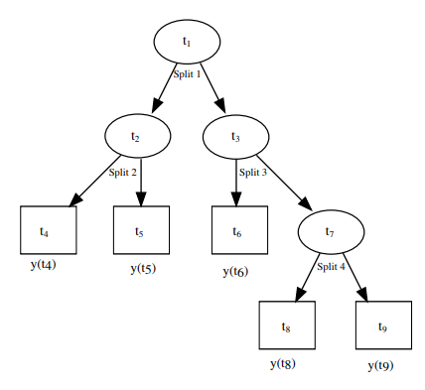
Introduction. CART and EAT
CART works like a:
classification model
regression model
Notes:
Specifically, this Machine learning technique is CART that works for both classification and regression, but due to the nature of the target variable we are working with, we only focus on regression.
And why CART? Because if you look at the estimates returned by the technique, it has a step shape similar to that of the FDH.
That is why this Figure inspired us to study whether there was a relationship between FDH, from the world of Efficiency Analysis, and CART, from the world of Machine Learning. And, indeed, it turned out that there was.
In addition, another advantage of CART is the visualisation of the estimates, as we can see them in the form of a tree.

Slide 8
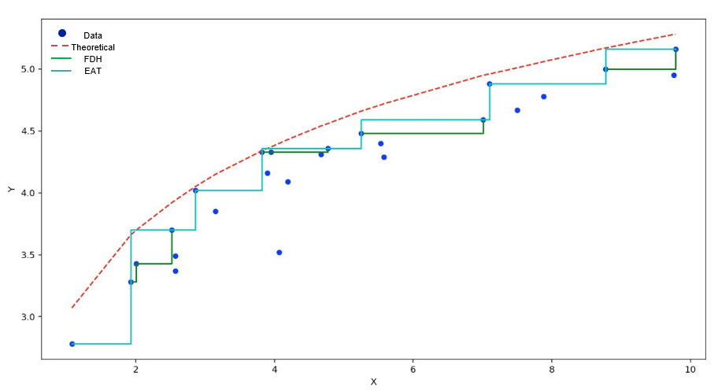
Introduction. FDH and EAT
FDH vs EAT
Esteve, M., Aparicio, J., Rabasa, A., & Rodriguez-Sala, J. J. (2020). Efficiency analysis trees: A new methodology for estimating production frontiers through decision trees. Expert Systems with Applications, 162, 113783.
Notes:
The EAT also aims to define an estimator that ensures at each node the monotonicity property in the production function and, in turn, generates estimates that "envelop" the data on top of it, i.e. generate a tree-like method that results in a valid estimate of the production function, which is unknown, that gave rise to the sample data.
As we can see in this figure, the EAT does not over-fit the data so much that its predictive ability is greater. It is also closer to the theoretical production function, which is unknown (that is the discontinuous line).

Slide 9
Introduction. RF+EAT
Adapting the Random Forest technique to the Efficiency Analysis context
Contribute:
Better predictive performance. More robust predictions.
Determination of the importance of variables.
Solution of the “curse of dimensionality”
Notes:
EAT, like CART, has weaknesses such as low prediction robustness and high estimator variance.
Therefore, Random Forest comes into play, a Machine Learning technique to:
Better predictive performance. More robust predictions.
Determination of the importance of variables.
Solution of the “curse of dimensionality”

Slide 10
eat package
Introduction

Slide 11
eat package
Many of the standard models for estimating technical efficiency are available as R packages:
Neither of them fitting regression trees to estimate production frontiers in microeconomics and engineering like eat package
Benchmarking | nonparaeff |  | npbr
snfa |  | semsfa
Notes:
There are several standard R packages that estimate technical efficiency such as:
Benchmarking for estimating technologies and measuring efficiencies using Data Envelopment Analysis (DEA) and Stochastic Frontier Analysis (SFA)
nonparaeff for measuring efficiency and productivity using DEA and its variations
npbr which covers data envelopment techniques based on piece-wise polynomials, splines, local linear fitting, extreme values and kernel smoothing
snfa which fits both a smooth analogue of DEA and a non-parametric analogue of Stochastic Frontier Analysis (SFA)
Semsfa which estimates Stochastic Frontier Models by semiparametric or non-parametric regression techniques to relax parametric restrictions and applies a technique based on pseudolikelihood or the method of moments for estimating variance parameters.
However, neither of them fitting regression trees to estimate production frontiers satisfying the microeconomic principles of free disposability, convexity and deterministic data like the eat package.

Slide 12
eat package
Objective of the package:
The estimation of a production frontier through regression trees satisfying the microeconomic principles of free disposability, convexity and deterministic data
Notes:
The objective of the package is The estimation of a production frontier through regression trees satisfying the microeconomic principles of free disposability, convexity and deterministic data

Slide 13
eat package
Main functions

Slide 14
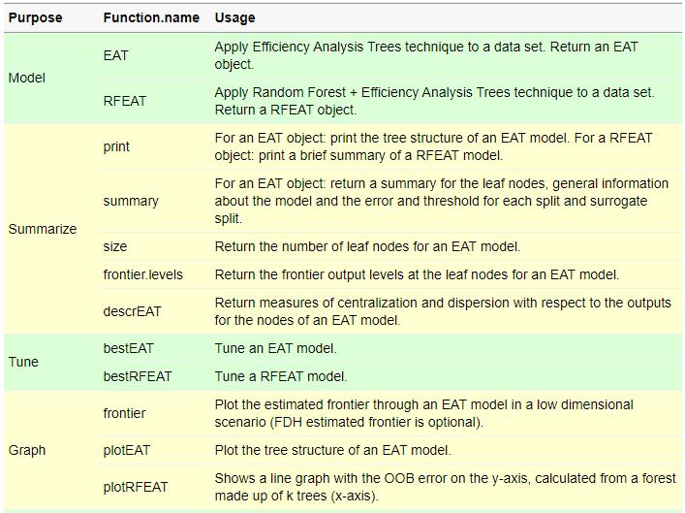
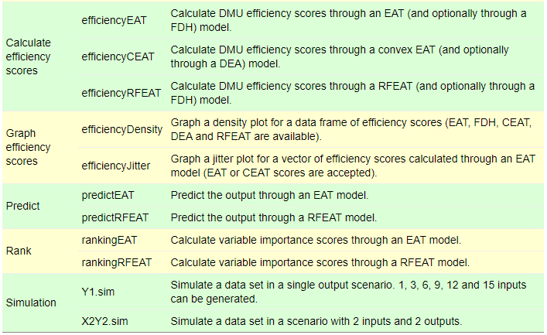
Main functions
The functions included in the eat package are summarized in the follow Table:
Notes:
the main functions available in the package are described in this table.
Of these, we highlight the functions that generate the EAT and RFEAT models (the first two). From the objects returned by these functions it is possible to plot the generated EAT tree, or the RFEAT errors with "plotEAT" and "plotRFEAT". We can also calculate from them various efficiency measures that are used in the efficiency analysis literature with these other functions. In addition, we can calculate the predictions that would be returned when new data are introduced with the predictor functions and obtain a ranking of the variables that most influence the analyses.

Slide 15
eat package
Empirical case

Slide 16
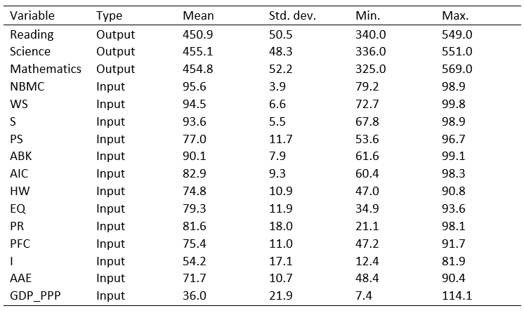
Empirical case. Database
PISA database
PISAindex
Notes:
For the empirical case we use the PISA 2020 database which is also available in the package under the name PISAindex.

Slide 17
Empirical case. Main models
Efficiency Analysis Trees (EAT)
modelEAT <- EAT(data = PISAindex,
x = 6:18, # input
y = 3:5 # output)
Random Forest for Efficiency Analysis Trees (RF+EAT)
modelRFEAT <- RFEAT(data = PISAindex,
x = 6:18, # input
y = 3:5, # output
numStop = 5,
m = 30,
s_mtry = "BRM",
na.rm = TRUE)
Notes:
With this database we create the basic models explained before.

Slide 18
Empirical case. Predictions
Efficiency Analysis Trees (EAT)
predictEAT(object = modelEAT, newdata = tail(data, 10), x = x)
-----------------------------------------------------------
S_PISA_pred R_PISA_pred M_PISA_pred
1 396 399 393
2 429 420 423
3 429 420 423
4 487 479 496
5 396 377 379
6 396 399 393
7 396 377 379
8 396 377 379
9 396 377 379
10 396 377 379
Notes:
With these models we can predict the output of new input data. In the parameter "object" we have specified the model we want to use.
In this case we have used the EAT model

Slide 19
Empirical case. Predictions
Random Forest for Efficiency Analysis Trees (RF+EAT)
predictRFEAT(object = modelRFEAT, newdata = tail(data, 10), x = x)
-----------------------------------------------------------
S_PISA_pred R_PISA_pred M_PISA_pred
1 400.02 393.18 401.92
2 421.78 418.16 413.56
3 420.74 417.80 412.44
4 448.74 447.32 443.68
5 382.60 368.40 371.38
6 412.02 411.96 412.58
7 384.54 371.28 373.22
8 392.58 382.12 382.94
9 379.28 365.68 370.52
10 376.30 364.94 365.42
Notes:
and in this case the RFEAT model.

Slide 20
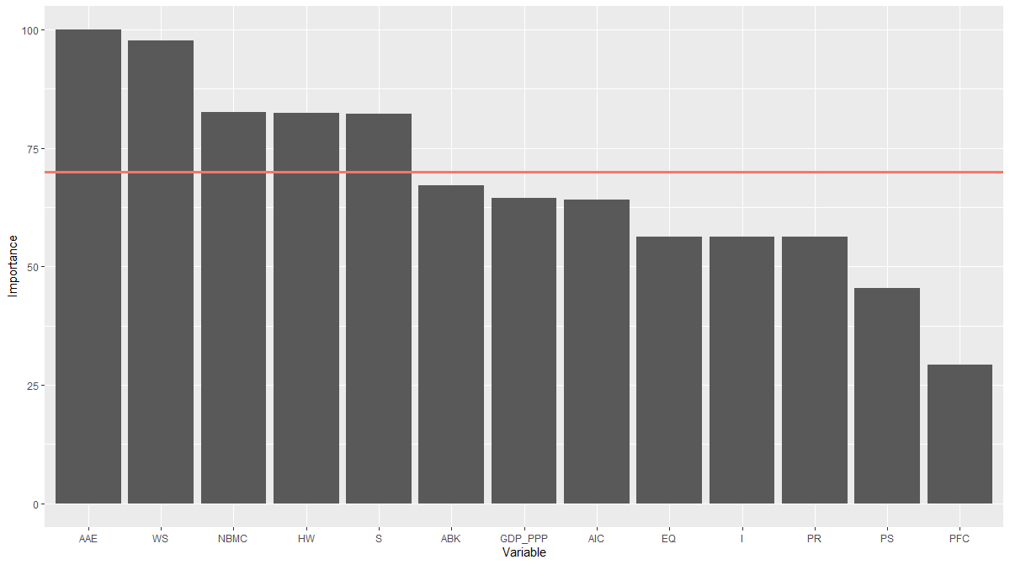
Empirical case. Importance of variables
Efficiency Analysis Trees (EAT)
rankingEAT(object = modelEAT, threshold = 70, barplot = TRUE, digits = 2)
--------------------------------------------------------
Importance
AAE 100.00
WS 97.65
NBMC 82.55
HW 82.49
S 82.24
ABK 67.16
GDP_PPP 64.54
AIC 64.08
EQ 56.29
PR 56.22
I 56.22
PS 45.38
PFC 29.35
Notes:
Ranking the importance of variables is also possible using this function. It returns a list with the numerical value of the importance of each variable and a graph.
This function can be used for the EAT

Slide 21
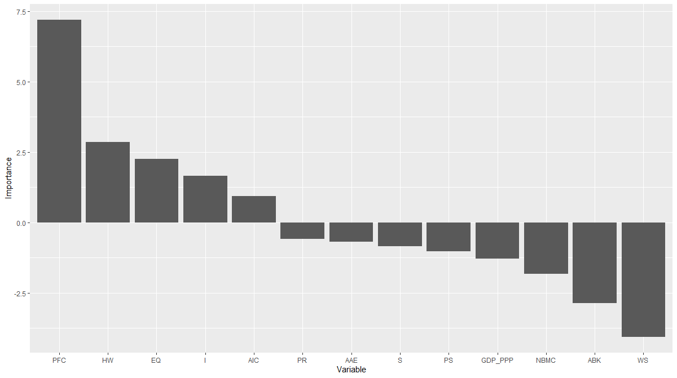
Empirical case. Importance of variables
Random Forest for Efficiency Analysis Trees (RF+EAT)
rankingRFEAT(object = modelRFEAT, barplot = TRUE)
---------------------------------------------------------
Importance
PFC 7.1977380
HW 2.8658000
EQ 2.2628482
I 1.6523514
AIC 0.9298688
PR -0.5867114
AAE -0.6801898
S -0.8349269
PS -1.0268028
GDP_PPP -1.2789753
NBMC -1.8264092
ABK -2.8606368
WS -4.0611915
Notes:
and for the RFEAT.

Slide 22
Empirical case. Basic models
The efficiency scores are numerical values that indicate the degree of efficiency of a set of Decision Making Units (DMUs)
BCC.OUT: The output-oriented radial model
BCC.INP: The input-oriented radial model
RSL.OUT: The output-oriented Russell Model
RSL.INP: The input-oriented Russell Model
DDF: The Directional Distance Function
WAM.MIP: The Measure of Inefficiency Proportions as a type of Weighted Additive Model
WAM.RAM: The Range-Adjusted Measure of Inefficiency as a type of Weighted Additive Model
Notes:
The efficiency scores are numerical values that indicate the degree of efficiency of a set of Decision Making Units (DMUs).
All these types of measures can be found in the literature on efficiency analysis. Therefore, they have all been included in our "eat" package.

Slide 23
Empirical case. Basic models
EAT_BCC_out FDH_BCC_out
SGP 1.000 1.000
JPN 1.042 1.000
KOR 1.000 1.000
…
PAN 1.000 1.000
PHL 1.074 1.000
DOM 1.102 1.000
Model Mean Std. Dev. Min Q1 Median Q3 Max
EAT 1.02 0.03 1 1 1.01 1.01 1.16
Model Mean Std. Dev. Min Q1 Median Q3 Max
FDH 1 0.01 1 1 1 1 1.04
eff <- efficiencyEAT(data = PISAindex,
x = c(6:18),
y = c(3,4,5),
object = modelEAT,
scores_model = “BCC.OUT”,
digits = 3,
FDH=TRUE,
na.rm = TRUE)
Notes:
To calculate the efficiency of the EAT model we must indicate in the parameter "object" the EAT model we built at the beginning of the empirical case; then in "scores_model" indicate the type of efficiency measure we want to apply; and, finally, indicate if we want to calculate the efficiency of the FDH as well.

Slide 24
Empirical case. Basic models
RFEAT_BCC_out FDH_BCC_out
SGP 0.968 1.000
JPN 1.005 1.000
KOR 0.993 1.000
…
PAN 1.016 1.000
PHL 1.034 1.000
DOM 1.066 1.000
Model Mean Std. Dev. Min Q1 Median Q3 Max
RFEAT 1.01 0.03 0.96 0.99 1 1 1.1
Model Mean Std. Dev. Min Q1 Median Q3 Max
FDH 1 0.01 1 1 1 1 1.04
eff <- efficiencyRFEAT(data = PISAindex,
x = c(6:18),
y = c(3,4,5),
object = modelRFEAT,
digits = 3,
FDH=TRUE)
Notes:
In the case of RF+EAT we would enter the RF+EAT model and if we want to calculate the efficiency of the FDH. In this case there is only one way to measure the efficiency, i.e. the BCC output orientation.

Slide 25
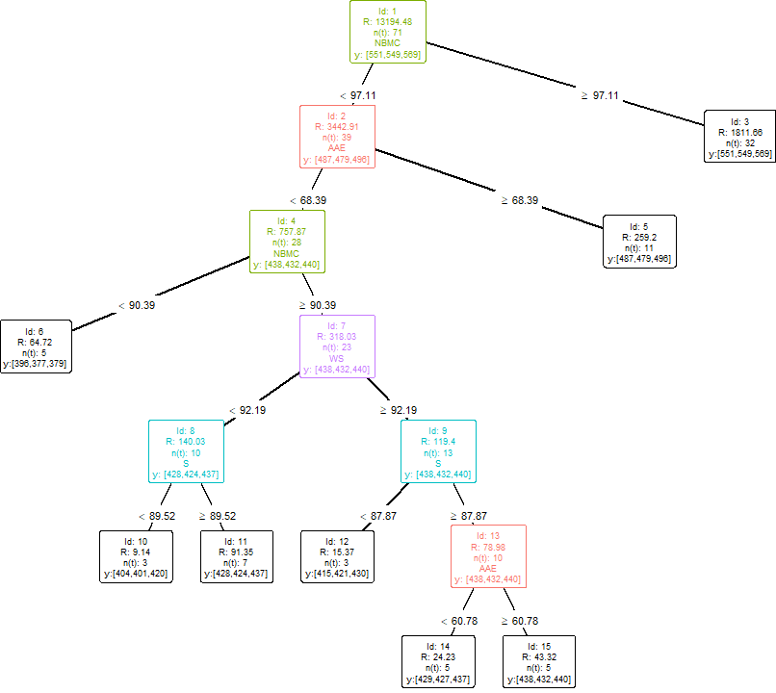
Empirical case. Exporting results
plotEAT(object = modelEAT)
Notes:
As mentioned at the beginning, the package returns graphics such as the generated EAT tree,

Slide 26
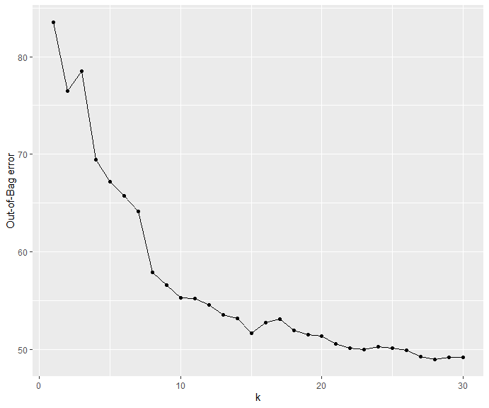
Empirical case. Exporting results
plotRFEAT(object = modelRFEAT)
Notes:
and the Out-Of-Bag error of the "k" trees generated by the RF+EAT.

Slide 27
Conclusion and future work

Slide 28
Conclusion
The eat package allows the estimation of production frontiers in microeconomics and engineering through suitable adaptations of Regression Trees and Random Forest.
Several functions have been implemented in the eat package for:
graphing the results
calculating a ranking of importance of inputs
comparing the efficiency scores estimated by EAT with respect to the DEA and FDH
Notes:
To conclude …

Slide 29
Thank you for your attention
useR 2021

